Slide 1


By-
PRAGATI SHINDE M.Sc. (Statistics)
WELCOME IN

Slide 2
CELL REFERENCING
A cell reference refers to a cell or a range of cells on a worksheet.
The true advantage of cell references is that they allow you to update data in your worksheet without having to rewrite formulas.
When you change the value in a cell, the formula calculates the new result automatically.
There are three types of referencing.

Slide 3
`
Types of Referencing
1
1. Relative Referencing
2. Absolute Referencing
2
3. Mixed Referencing
3

Slide 4
1.Relative Referencing
By default, a cell reference in Excel, is Relative Referencing.
It means that the reference is relative to the location of the cell.
When copied across multiple cells, the change based on relative position of rows and columns.
e.g. C5*D5

Slide 5
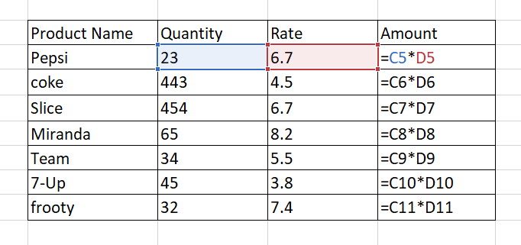
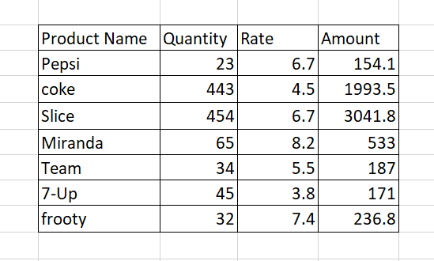
Output:

Slide 6
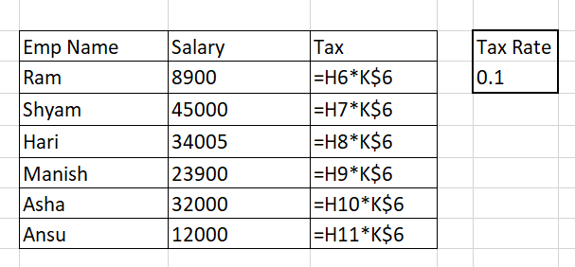
2. Absolute Referencing
If you want to maintain the original cell reference when you copy it, you “lock” it by putting a dollar sign($) before the cell and column reference.
E.g. H6*K$6 (if we want to lock 6th row)

Slide 7
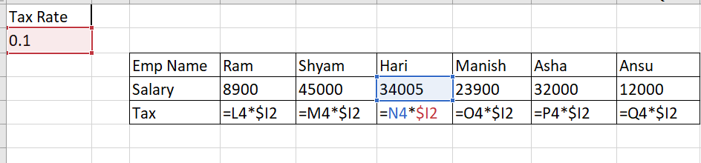
E.g. L4*$I2( If we want to lock I th column)
I

Slide 8
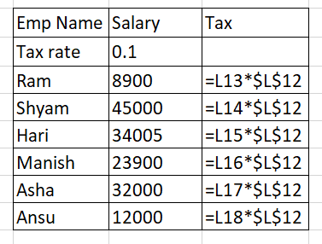
E.g. $A$1(If we want to lock both row or column)

Slide 9
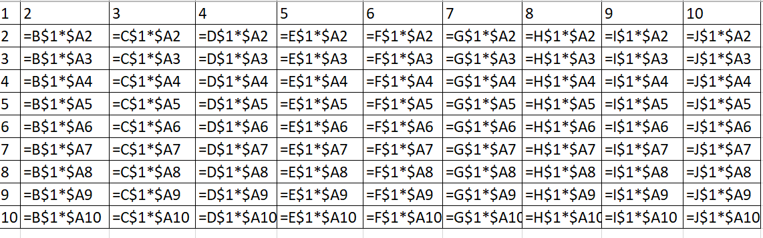
3.Mixed Referencing
Mixed reference in Excel is used to fix either column or row simultaneously.
E.g. B$1*$A2

Slide 10
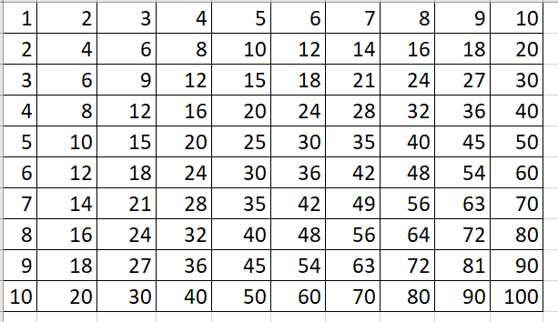
oo
Output:

Slide 11
Short Cut Keys
(fn)Function key + f4 --->To freeze cell
Ctrl + ~ ---> To see the formula in cells(Show formula)
Ctrl + Enter ---> fills the selected cells with current entry

Slide 12
THANK YOU

